Slide 1
Statistics
Discrete Probability Distribution

Slide 2
A random variable is a numerical description of the outcome of an experiment.
A random variable can be classified as being either discrete or continuous depending on the numerical values it assumes

Slide 3
A random variable that may assume either a finite number of values or an infinite sequence of values such as 0, 1, 2,...is referred to as a discrete random variable.
Countable
How many
Eg:discrete random variable, consider the experiment of cars arriving at a toll booth.

Slide 4
Example:
Number of customers who place an order
Number of defective radios
Number of customers
Gender of the customer

Slide 5
A random variable that may assume any numerical value in an interval or collection of intervals is called a continuous random variable.
Time between customer arrivals x 0 in minutes
Percentage of project complete after 0 x 100 six months

Slide 6
Experimental outcomes based on measurement scales such as time, weight, distance, and temperature can be described by continuous random variables.
Eg: Between 0 to 1 , all Values

Slide 7
Discrete probability distribution
For a discrete random variable x, the probability distribution is defined by a probability function, denoted by f(x).
The probability function provides the probability for each value of the random variable

Slide 8
Discrete P
x = the number of automobiles sold during a day.
f(0) provides the probability of 0 automobiles sold,
f(1) provides the probability of 1 automobile sold, and so on.
if historical data show 54 of 300 days with 0 automobiles sold, we assign the value 54/300 = .18 to f(0),

Slide 9


Slide 10
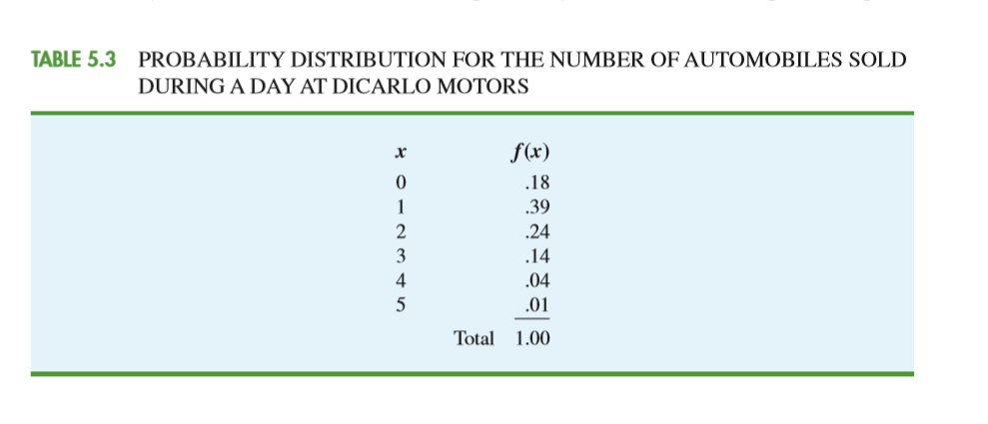

Slide 11
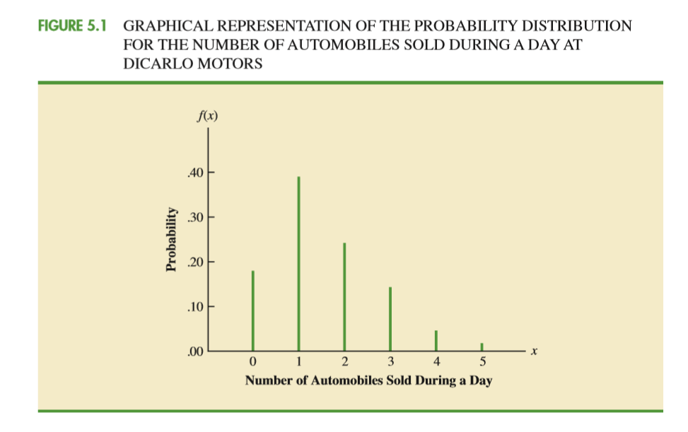
Graph

Slide 12
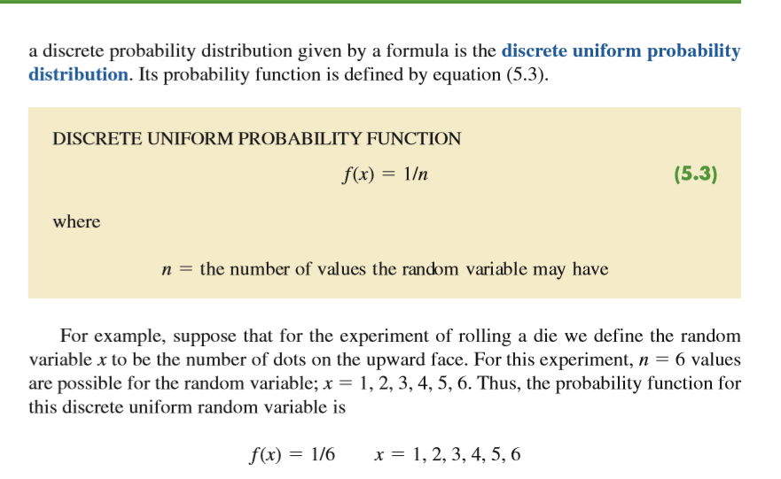

Slide 13
Three important cases are the
binomial,
Poisson, and
hypergeometric distributions

Slide 14

expected value, or mean
The expected value, or mean, of a random variable is a measure of the central location for the random variable.
Mu

Slide 15

variance
measure of variability, or dispersion
The notations Var(x) andσ2 are both used to denote the variance of a random variable.

Slide 16
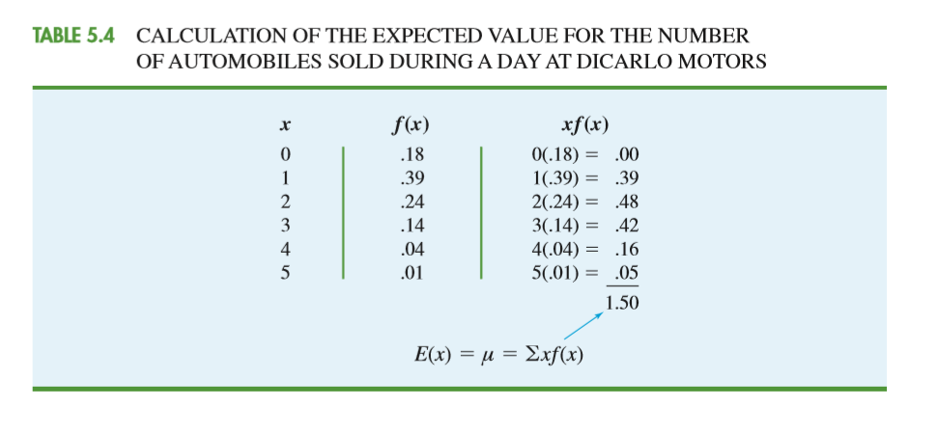
Sum of (x * f(x))

Slide 17
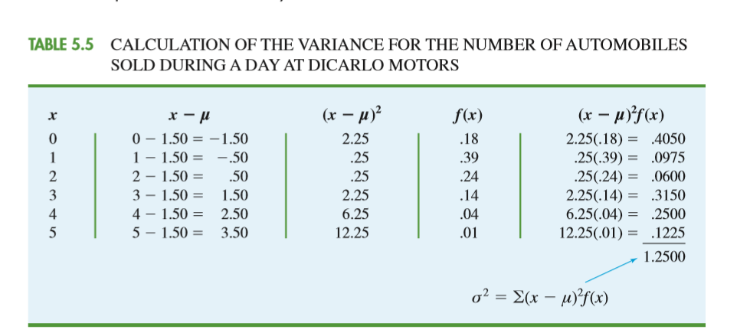
Variance, standard Deviation

Slide 18

standard deviation
We see that the variance is 1.25. The standard deviation, σ, is defined as the positive square root of the variance. Thus, the standard deviation for the number of automobiles sold during a day is
The standard deviation is measured in the same units as the random variable and therefore is often preferred in describing the variability of a random variable.
The variance σ2 is measured in squared units and is thus more difficult to interpret.

Slide 19
Binomial probability distribution
The binomial probability distribution is a discrete probability distribution that provides
many applications.
It is associated with a multiple-step experiment that we call the binomial experiment.

Slide 20
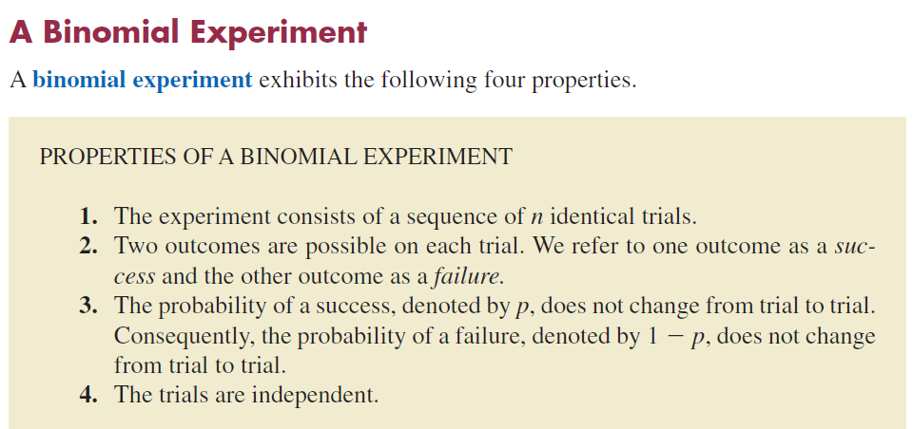

Slide 21
If properties 2, 3, and 4 are present, we say the trials are generated by a Bernoulli process.
If, in addition, property 1 is present, we say we have a binomial experiment.

Slide 22
In a binomial experiment, our interest is in the number of successes occurring in the n trials.
If we let x denote the number of successes occurring in the n trials , x is a discrete random variable

Slide 23
The experiment consists of five identical trials;
each trial involves the tossing of one coin.
Two outcomes are possible for each trial: a head or a tail. We can designate head a success and tail a failure.
The probability of a head and the probability of a tail are the same for each trial,
with p .5 and 1 p .5.
The trials or tosses are independent because the outcome on any one trial is not affected by what happens on other trials or tosses

Slide 24
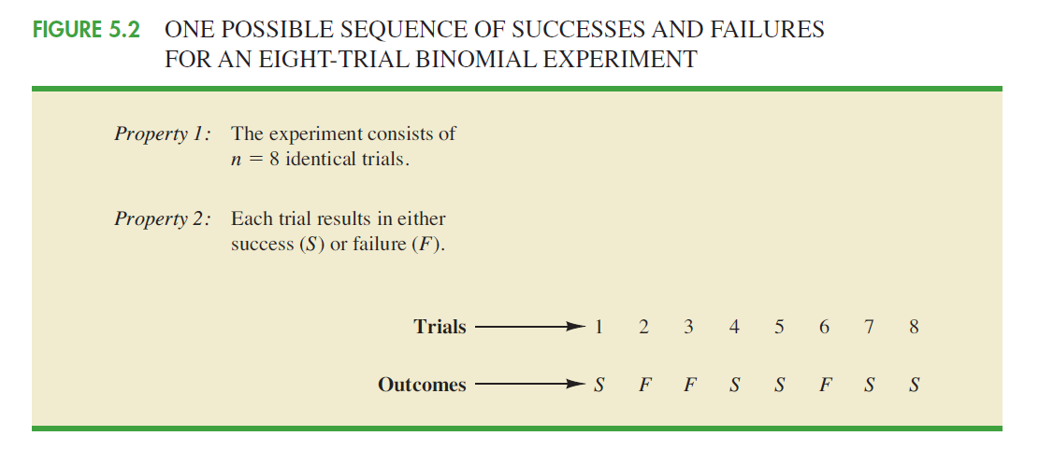

Slide 25
binomial probability function, can be used to compute the probability of x successes in the n trials.

Slide 26
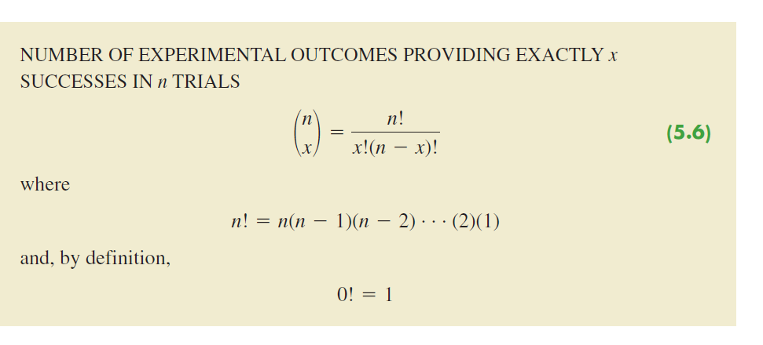

Slide 27
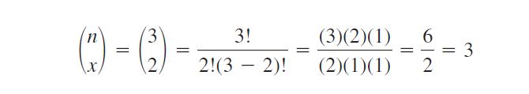

Slide 28
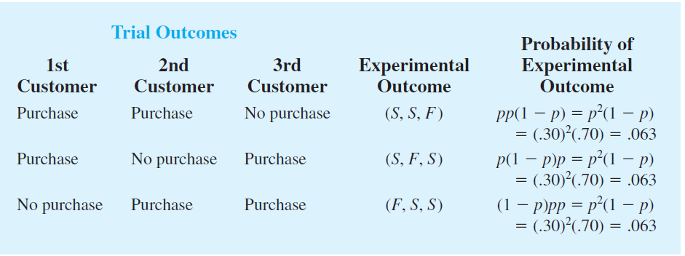

Slide 29
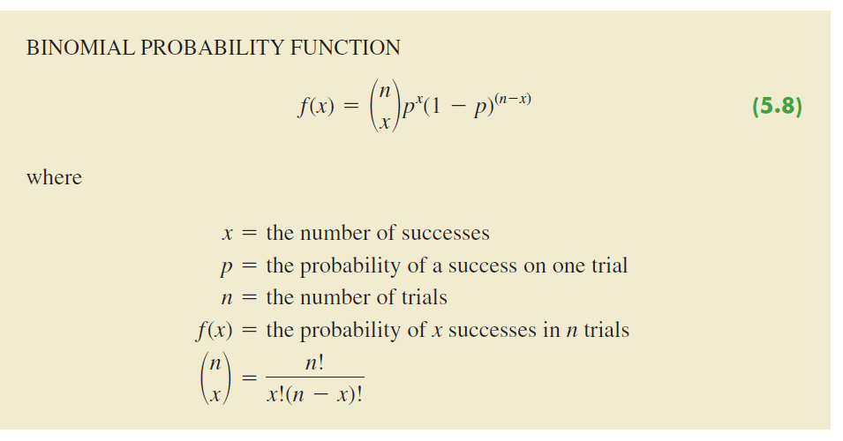

Slide 30
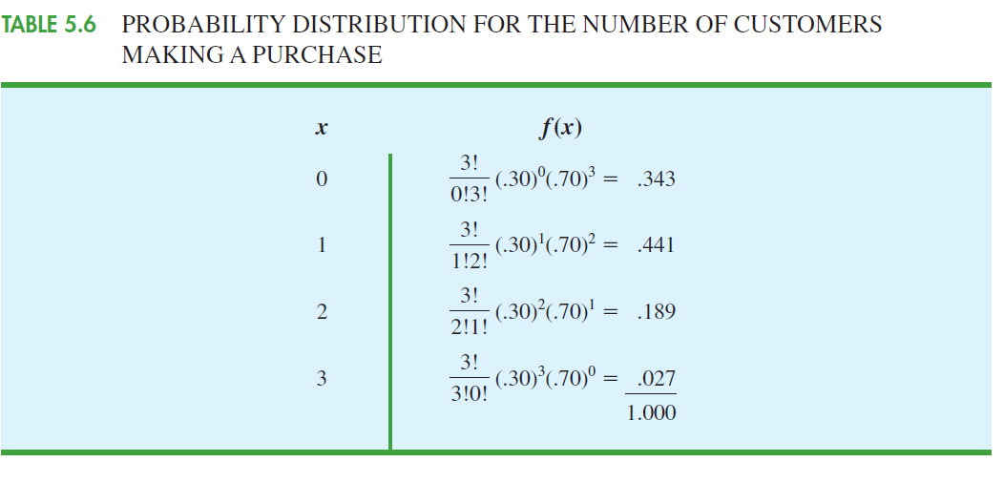

Slide 31
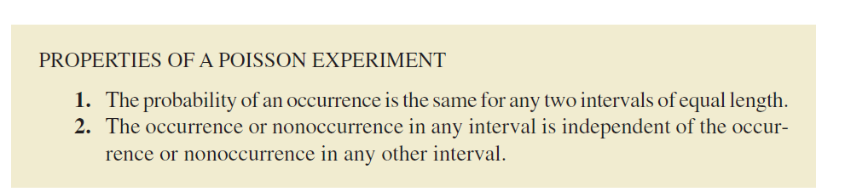
Poisson probability distribution
estimating the number of occurrences over a specified interval of time or space

Slide 32
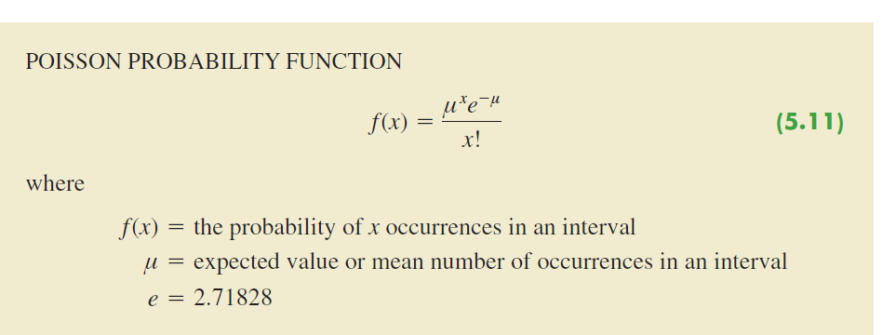

Slide 33
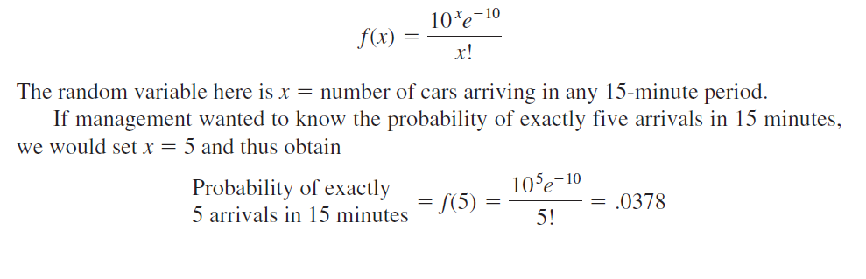
average number of cars arriving in a 15-minute period of time is 10;

Slide 34
A property of the Poisson distribution is that the mean and variance are equal.

Slide 35
hypergeometric probability distribution
The hypergeometric probability distribution is closely related to the binomial distribution.
The two probability distributions differ in two key ways. With the hypergeometric distribution,
the trials are not independent;
and the probability of success changes from
trial to trial.

Slide 36
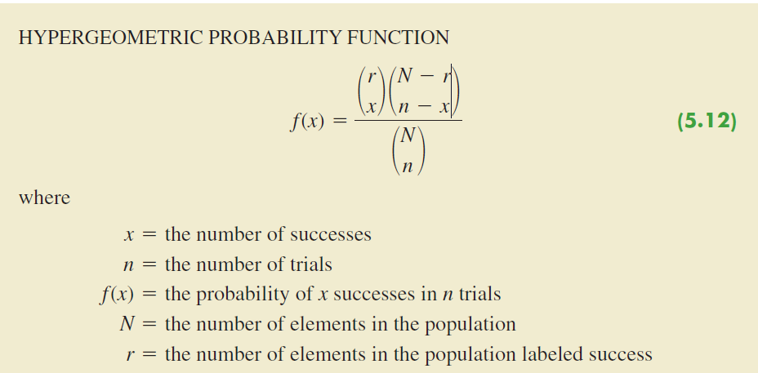

Slide 37
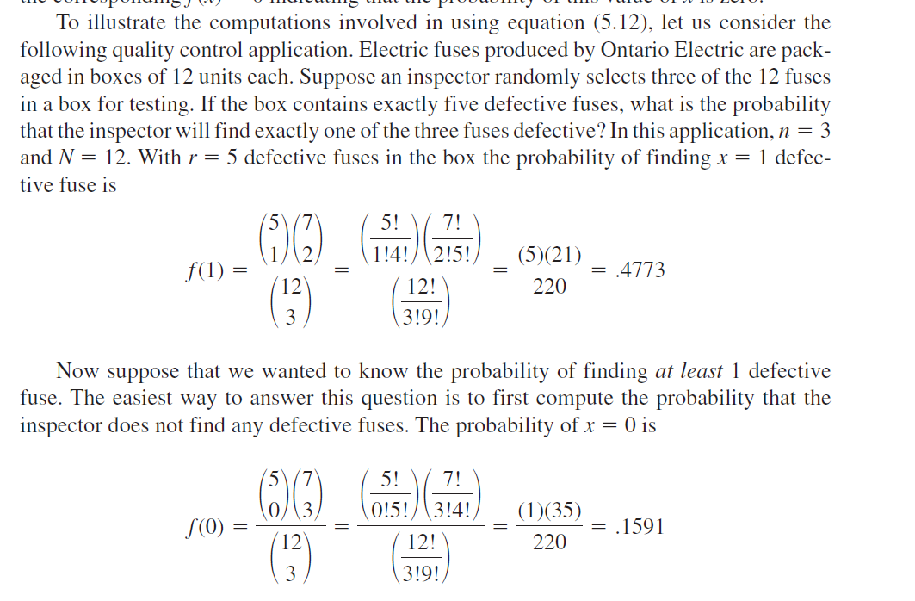

Slide 38
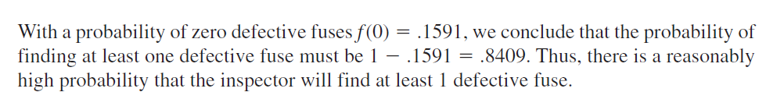

Slide 39
continuous probability distributions
the uniform,
the normal, and
the exponential

Slide 40
uniform probability distribution
Whenever the probability is proportional to the length of the interval, the random variable is uniformly distributed.
Consider the random variable x representing the flight time of an airplane traveling from
Chicago to New York. Suppose the flight time can be any value in the interval from 120 minutes to 140 minutes.

Slide 41
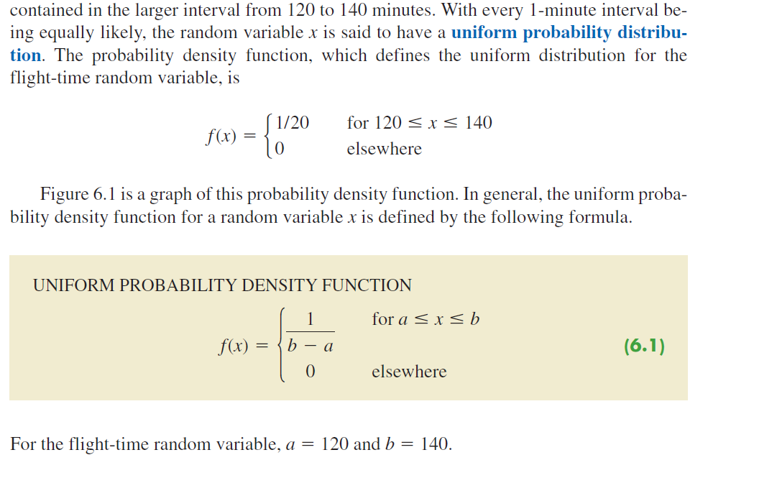

Slide 42
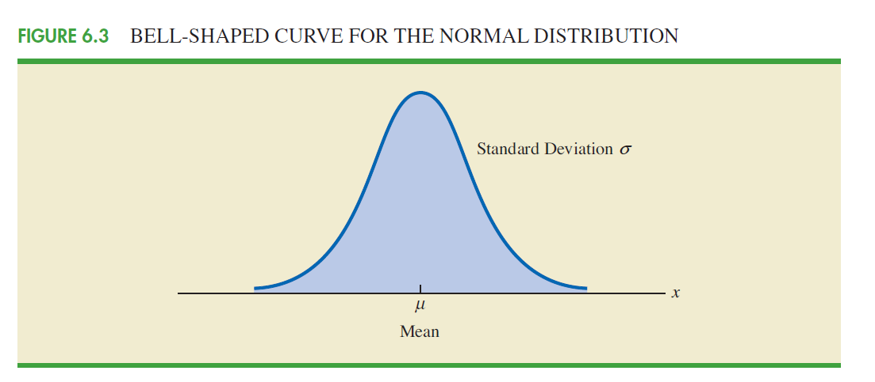
normal probability distribution

Slide 43
We make several observations about the characteristics of the normal distribution.
1. The entire family of normal distributions is differentiated by two parameters: the mean μ and the standard deviation σ.
2. The highest point on the normal curve is at the mean, which is also the median and mode of the distribution.
3. The mean of the distribution can be any numerical value: negative, zero, or positive.

Slide 44
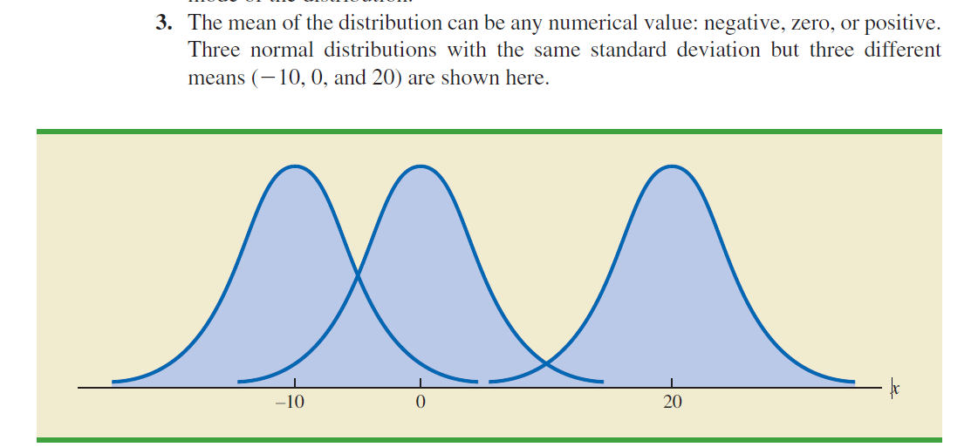
.

Slide 45
4. The normal distribution is symmetric, with the shape of the normal curve to the left of the mean a mirror image of the shape of the normal curve to the right of the mean. The tails of the normal curve extend to infinity in both directions and theoretically never touch the horizontal axis. Because it is symmetric, the normal distribution is not skewed; its skewness measure is zero.
5. The standard deviation determines how flat and wide the normal curve is. Larger values of the standard deviation result in wider, flatter curves, showing more variability in the data.

Slide 46
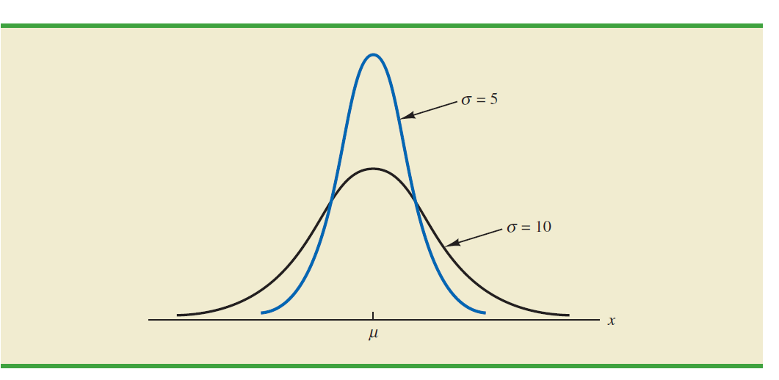

Slide 47
Probabilities for the normal random variable are given by areas under the normal
curve. The total area under the curve for the normal distribution is 1. Because the
distribution is symmetric, the area under the curve to the left of the mean is .50 and the area under the curve to the right of the mean is .50.
7. The percentage of values in some commonly used intervals are
a. 68.3% of the values of a normal random variable are within plus or minus one
standard deviation of its mean.
b. 95.4% of the values of a normal random variable are within plus or minus two
standard deviations of its mean.
c. 99.7% of the values of a normal random variable are within plus or minus three
standard deviations of its mean.

Slide 48
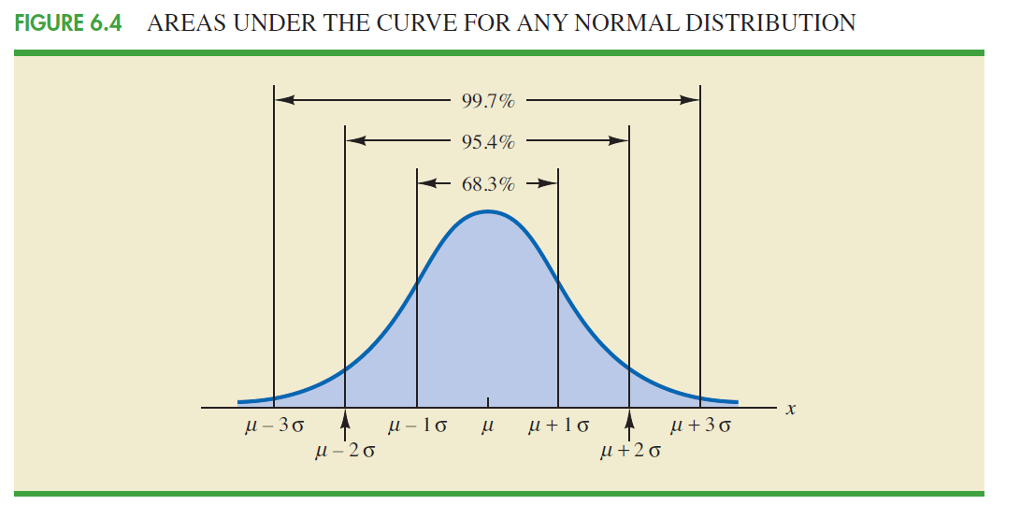

Slide 49
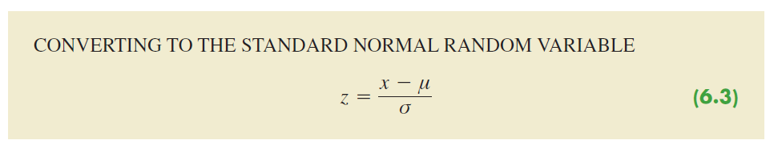
Z

Slide 50
exponential probability distribution

Slide 51
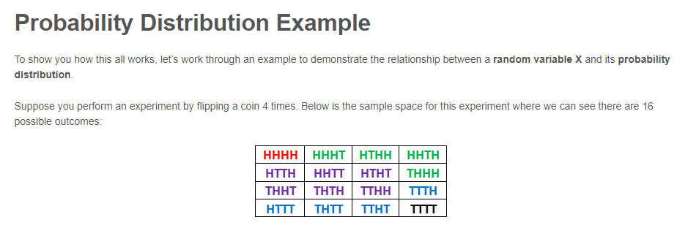

Slide 52
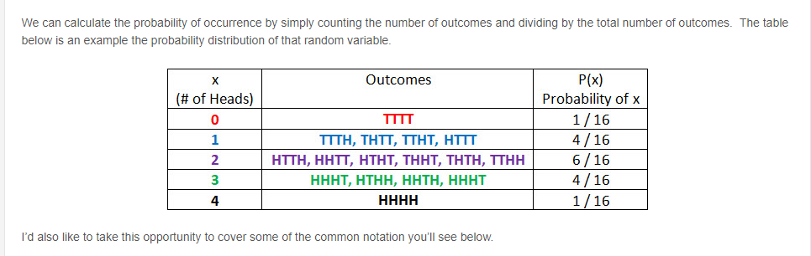

Slide 53
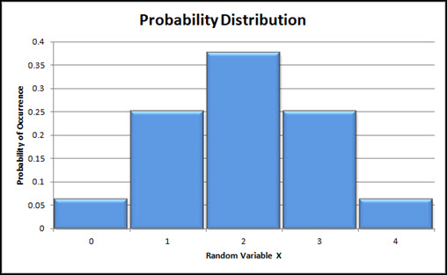

Slide 54
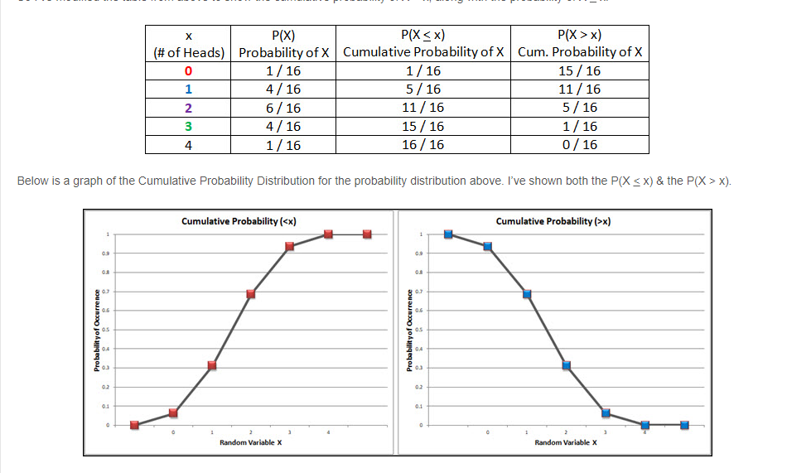

Slide 55
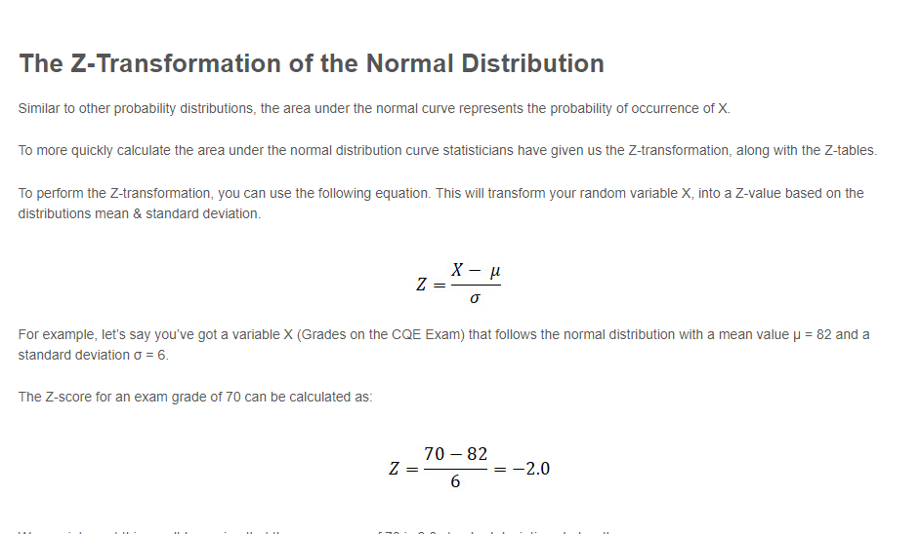

Slide 56
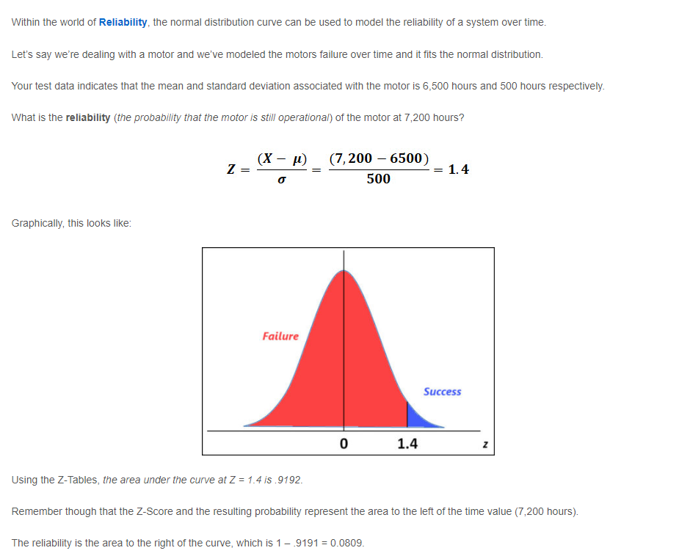

Slide 57
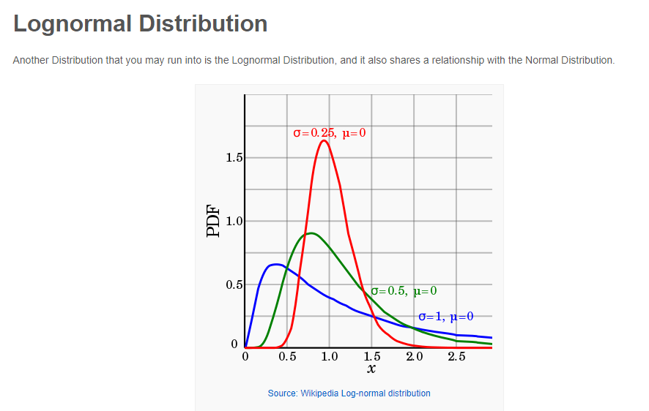

Slide 58
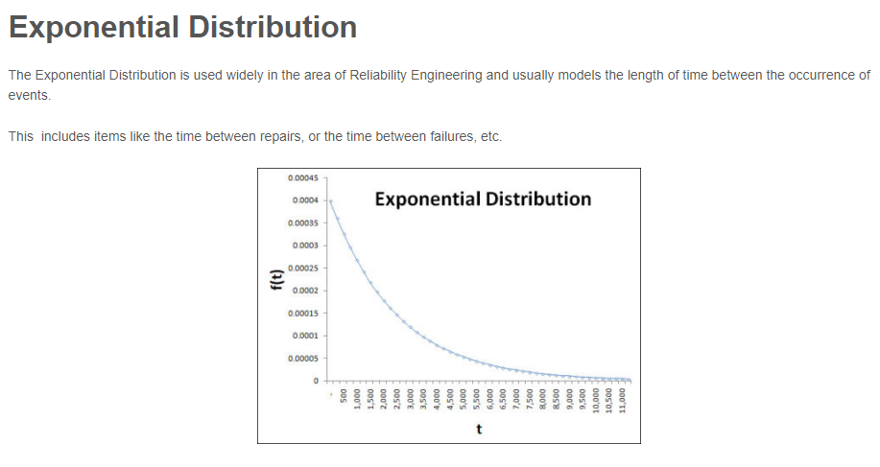

Slide 59
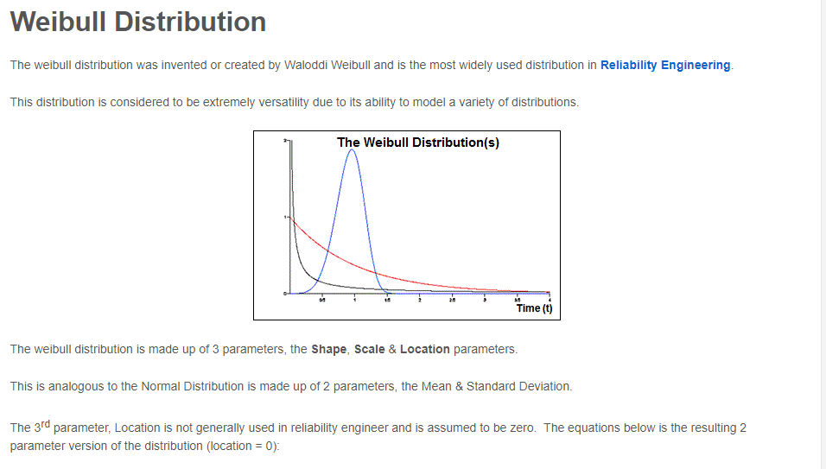

Slide 60
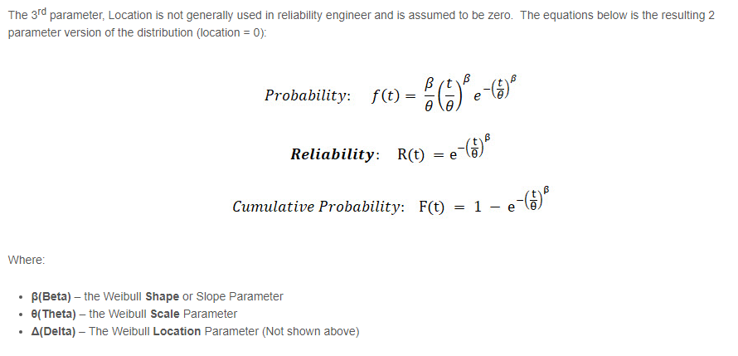

Slide 61
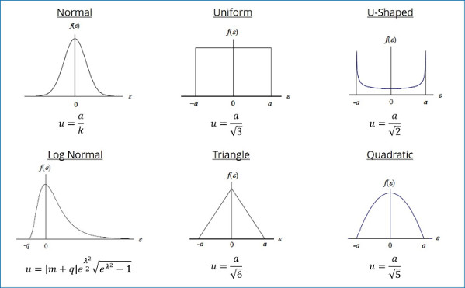

Slide 62

Compound Probability

Slide 63

With & without Replacement ( 5/15, 5/14)

Slide 64
Conditional P
Conditional probability is the probability of one event occurring with some relationship to one or more other events. For example:
Event A is that it is raining outside, and it has a 0.3 (30%) chance of raining today.
Event B is that you will need to go outside, and that has a probability of 0.5 (50%).
A conditional probability would look at these two events in relationship with one another, such as the probability that it is both raining and you will need to go outside.

Slide 65
The formula for conditional probability is: P(B|A) = P(A and B)
/ P(A)
which you can also rewrite as: P(B|A) = P(A∩B) / P(A)

Slide 66
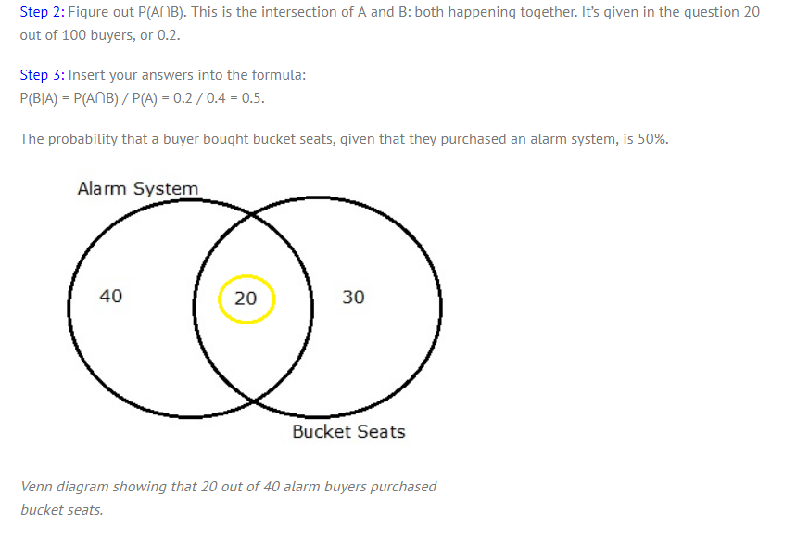

Slide 67
The formula for conditional probability is derived from the probability multiplication rule, P(A and B) = P(A)*P(B|A).
You may also see this rule as P(A∪B).

Slide 68
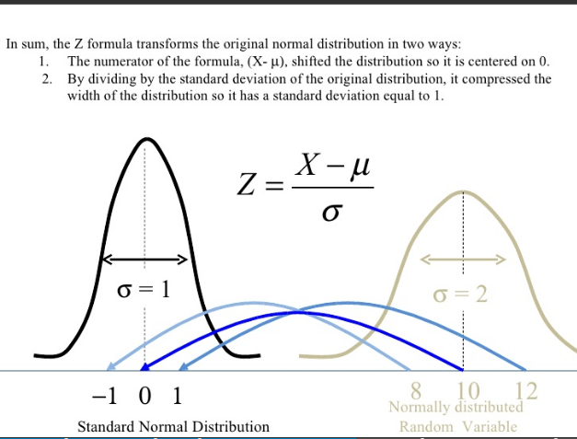

Slide 69
Joint probability is the likelihood of more than one event occurring at the same time. ( = compound Probability)
P(A)=0.1666 P(B)=0.1666
P(A,B)=0.1666 x 0.1666)=0.02777
P(A) * P(B)

Slide 70
Joint probability is a useful statistic for analysts and statisticians to use when two or more observable phenomena can occur simultaneously (for example, a decline in the Dow Jones Industrial Average accompanied by a substantial loss in the value of the dollar). It indicates the likelihood two separate events will occur simultaneously.
However, it is important to know that joint probability cannot be used to determine how much the occurrence of one event influences the occurrence of another event.
For this, one would need to calculate a conditional probability.

Slide 71
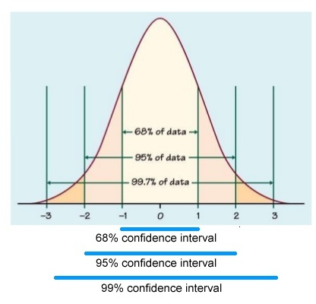
Confidence Intervals

Slide 72
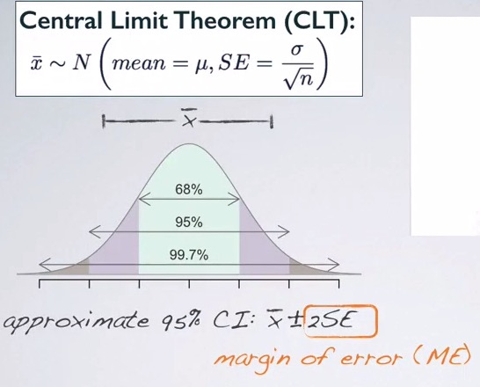
Confidence interval is the range of plausible values in which we want to capture the population parameter.

Slide 73
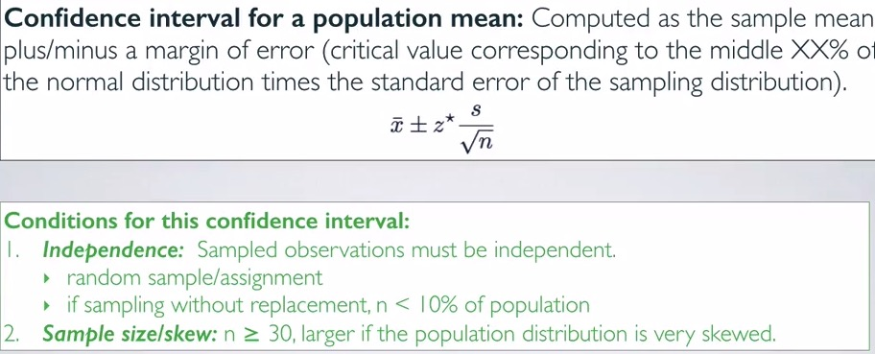

Slide 74
A 2008 Gallup survey found that TV ownership may be good for wellbeing. The results from the poll stated that the confidence level was 95% +/-3, which means that if Gallup repeated the poll over and over, using the same techniques, 95% of the time the results would fall within the published results. The 95% is the confidence level and the +/-3 is called a margin of error.

Slide 75
10 Patients ( Df 10-1 = 9)
240 = mean weight
25 = Standard Deviation
Find CI for 95% CI
(1-0.95)/2 = 0.025
At Df – 9, at 0.025 = 2.262 (t-distribution-table )
25/ Sqrt of 10 = 7.905
2.261 * 7.905 = 18
240 + /- 18

Slide 76
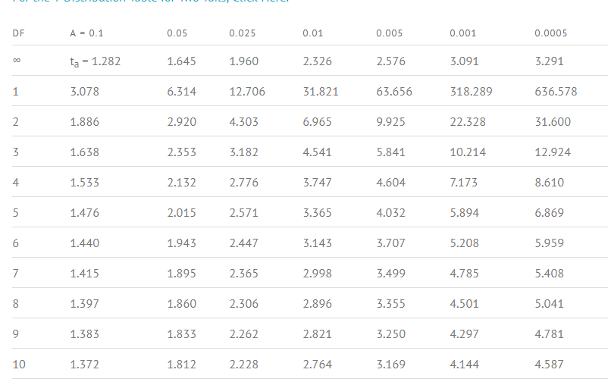

Slide 77


Slide 78
